Slide 1
Predicting Car Accident Severity
Submitted by:
Vipul Gupta

Slide 2
Predicting Accident Severity will Ensure Better Safety
In most cases, not paying enough attention during driving, abusing drugs and alcohol or driving at very high speed are the main causes of occurring accidents that can be prevented by enacting harsher regulations.
Besides the aforementioned reasons, weather, visibility, or road conditions are the major uncontrollable factors that can be prevented by revealing hidden patterns in the data
In an effort to reduce the frequency of car collisions in a community, an algorithm must be developed to predict the severity of an accident given the current weather, road and visibility conditions.
When conditions are bad, this model will alert drivers to remind them to be more careful.

Slide 3
Data Acquisition And Cleaning
We download the dataset from the Seattle Open GeoData Portal.
We can see that the dataset contains 194673 records and 37 fields.
The metadata of the dataset can be found from the website of the Seattle Department of Transportation.
The dataset was unbalanced and therefore was made balanced by dropping some rows randomly.
After balancing the dataset, the features with zero or partial contribution have been removed.
The clean data consists of 9 features.
Further, there were some categorical fields which can’t be fed to the ML model directly, therefore one-hot encoding has been applied to convert the fields as integer type.
Perfectly Balanced!

Slide 4
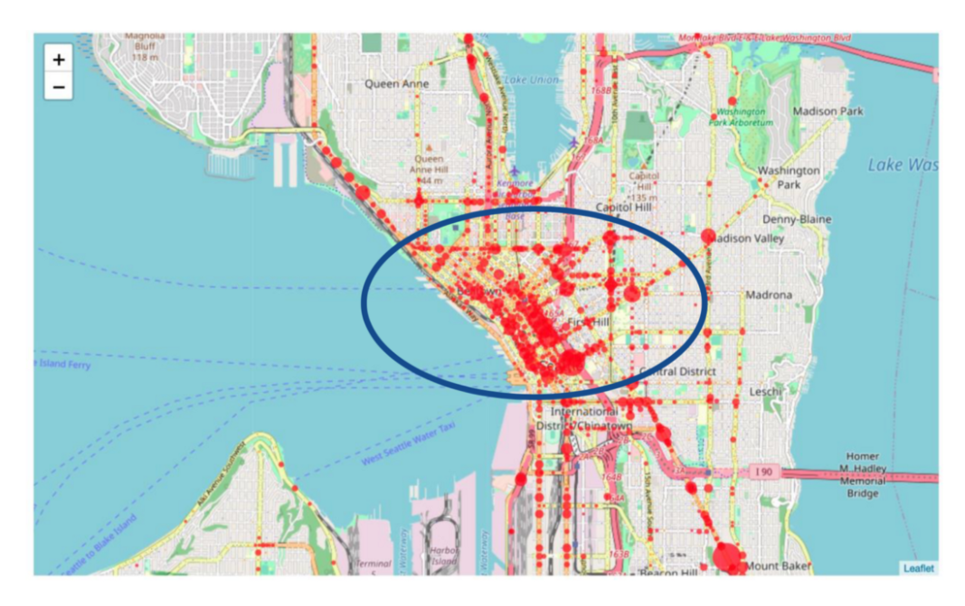
Collision Map
From the collision map, we can also clearly see the major area that car accidents happened.
Further, it can be divided w.r.t. the ADDRTYPE in 2 categories as BLOCK and INTERSECTION.

Slide 5
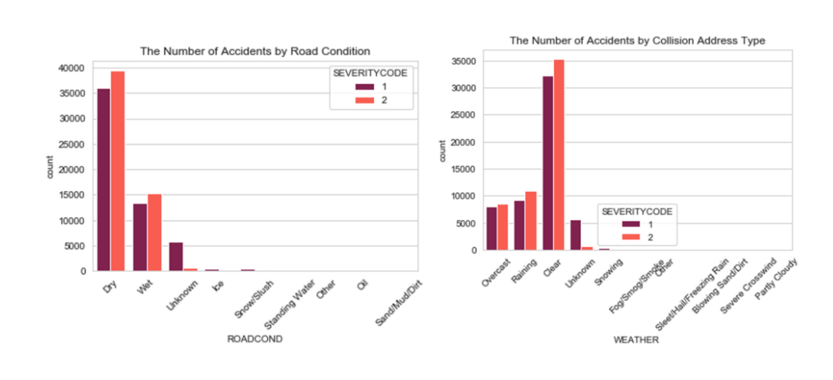
Road Condition and Weather

Slide 6
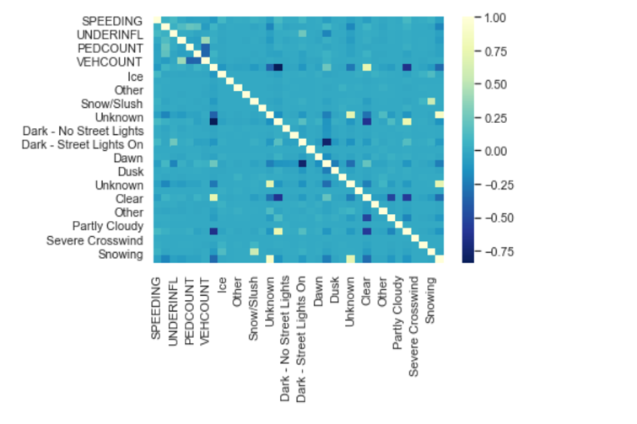
Correlation between Variables
Correlation is a statistical technique that can show whether and how strongly pairs of variables are related. Finding the correlation among the features of the dataset helps understand the data better.
In the heatmap shown below, it can be observed that some features have a strong positive / negative correlation while most of them have weak / no correlation.

Slide 7
Machine Learning Model
The objective is to create a model which can predict whether the accident is severe or not.
It is simply a classification problem.
For the classification model, we will be using the below models:
kNN
Decision Tree
Logistic Regression

Slide 8
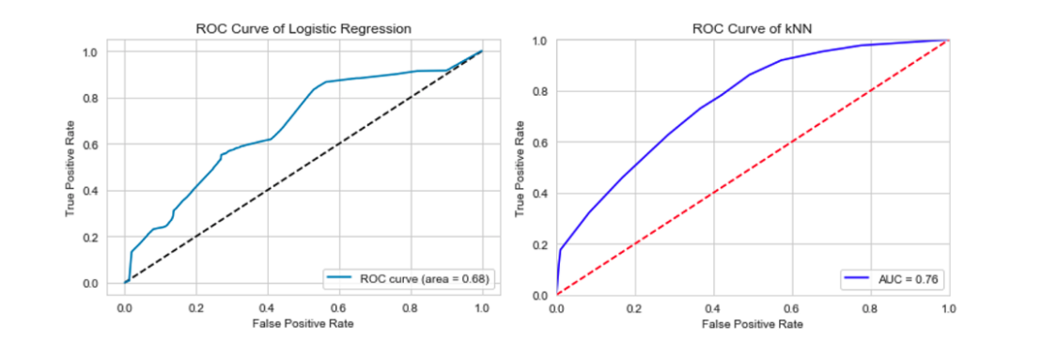
Model Evaluation
As per the results, the kNN model performed better with a ROC of 0.76 and 0.68 average F1 scores.

Slide 9
Conclusion and future directions
Based on the model and visualization, the light condition and road condition should be improved especially near First Hill. And also drivers can pay more attention to those factors when driving.
The prediction of car accident severity is not completely finished. Based on the result, the dataset is under fitted, which means I will need to collect more data and features such as speeding and alcohol using to better train the model.
In addition, the dataset only contains binary data for severity, however, there could be more scenarios for a car accident and also the people involved. I can stay tuned with the data and keep improving my models.

